Slide 1
Practical Statistics for Data science Review

Slide 2
Chapter 4
Regression and prediction

Slide 3

Introduction
The most common goal in statistics is to answer the question:
Is the variable X associated with a variable Y?
What is the relationship? and can we use it to predict Y?

Slide 4

Simpler linear regression
Models the relationship between the magnitude of one variable to another.
$$Y\sim βX$$
Quantifies the nature of the relationship i.e.
If X increases haw many times Y increases or decreases.

Slide 5
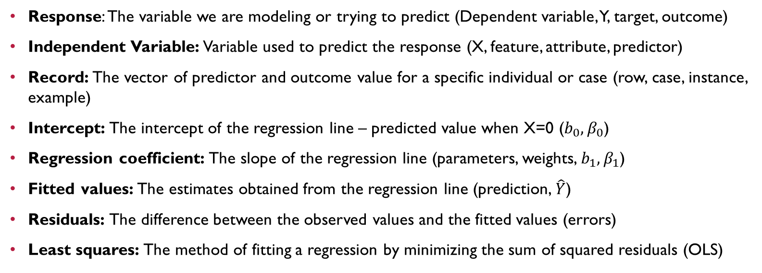
simple Linear regression Key terms
Response: The variable we are modeling or trying to predict (Dependent variable, Y, target, outcome)
Independent Variable: Variable used to predict the response (X, feature, attribute, predictor)
Record: The vector of predictor and outcome value for a specific individual or case (row, case, instance, example)
Intercept: The intercept of the regression line – predicted value when X=0 ($b_{0},β_{0}$)
Regression coefficient: The slope of the regression line (parameters, weights, $b_{1},β_{1}$)
Fitted values: The estimates obtained from the regression line (prediction, $\hat{Y}$)
Residuals: The difference between the observed values and the fitted values (errors)
Least squares: The method of fitting a regression by minimizing the sum of squared residuals (OLS)

Slide 6
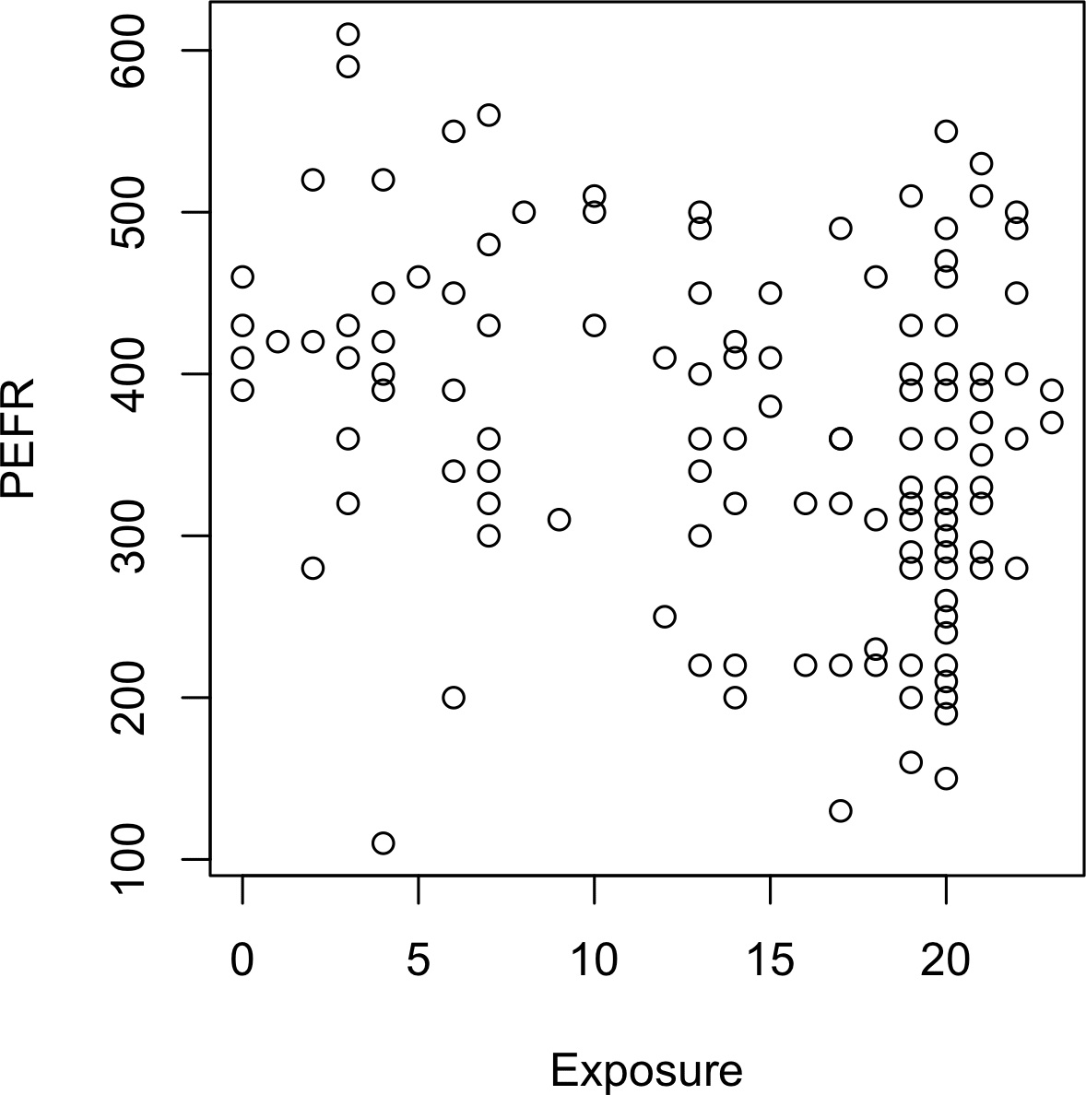


The regression Equation
Simple linear regression estimates exactly how much Y will change when X changes by a certain amount.
Consider the number of years a worker was exposed to cotton dust versus the measure of lung capacity (PEFR or Peak Expiratory Flow Rate).
The goal is to find the best line to predict the response PEFR as a function of the predictor variable Exposure.
Y$=b_{0}+b_{1}X$
PEFR$=b_{0}+b_{1}Exposure$

Slide 7
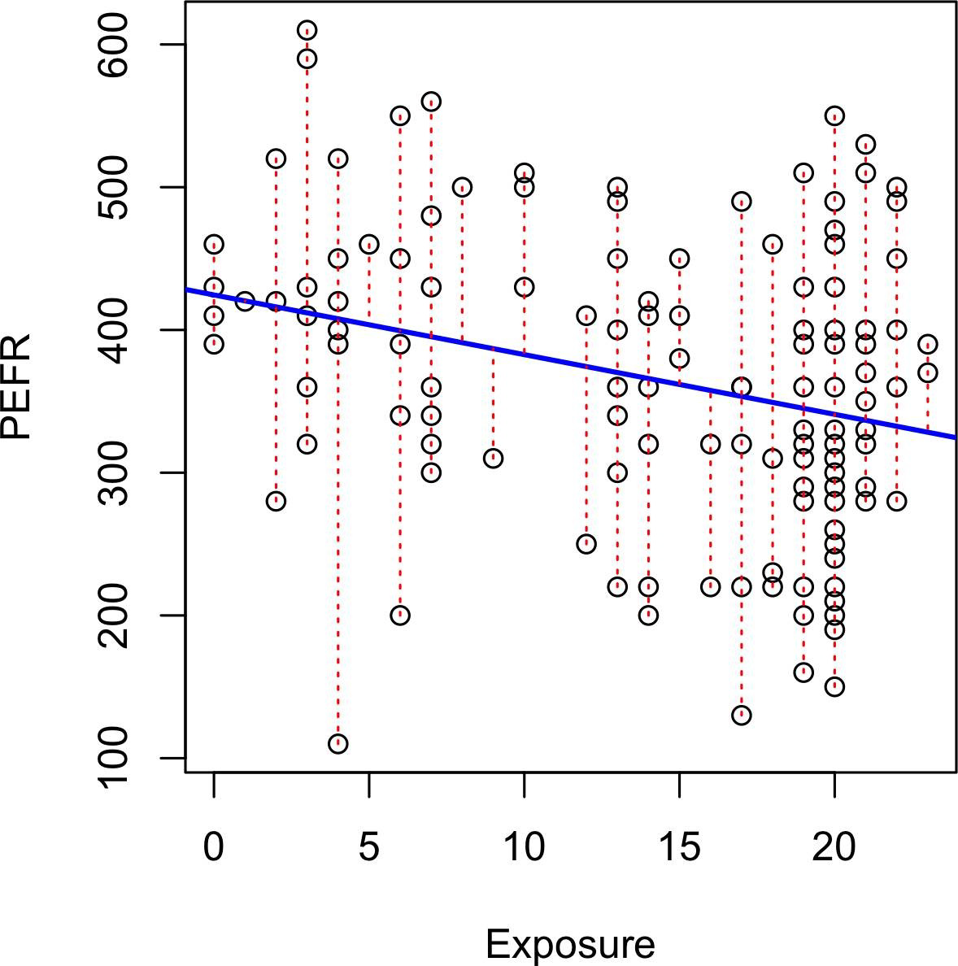

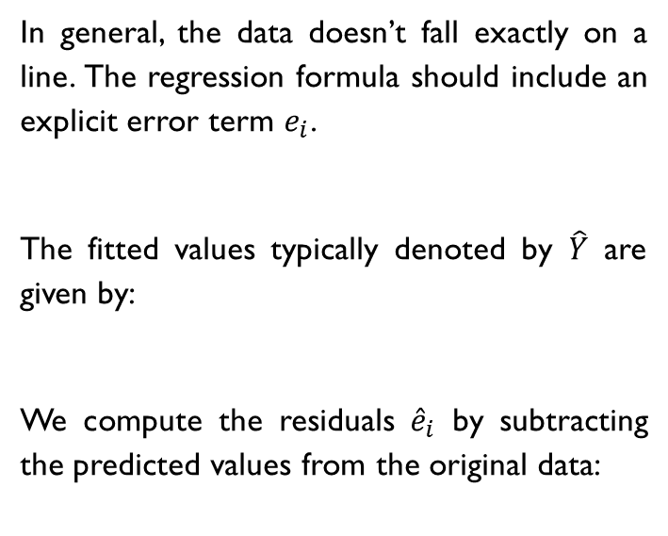


Fitted Values and Residuals
In general, the data doesn’t fall exactly on a line. The regression formula should include an explicit error term $e_{i}$.
The fitted values typically denoted by $\hat{Y}$ are given by:
We compute the residuals ${\hat{e}}_{i}$ by subtracting the predicted values from the original data:
$${\text{Y}}_{i}=b_{0}+b_{1}X_{i}+e_{i}$$
$${\hat{\text{Y}}}_{i}={\hat{b}}_{0}+{\hat{b}}_{1}X_{i}$$
$${\hat{\text{e}}}_{i}=Y_{i}+{\hat{Y}}_{i}$$

Slide 8


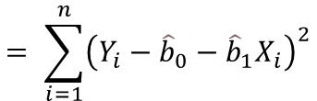
Ordinary Least Squares
How is the model fit to the data?
The regression line is the estimate that minimizes the sum of squared residuals.
This optimization leads to this simple formula to compute coefficients[proof]*:
$$RSS= \sum_{i=1}^{n}{{\left(Y_{i}−{\hat{Y}}_{i}\right)}^{2}}$$
$$= \sum_{i=1}^{n}{{\left(Y_{i}−{\hat{b}}_{0}−{\hat{b}}_{1}X_{i}\right)}^{2}}$$
$${\hat{b}}_{1}=\frac{\sum_{i=1}^{n}{\left(Y_{i}−\overline{Y}\right)}\left(X_{i}−\overline{X}\right)}{\sum_{i=1}^{n}{{\left(X_{i}−\overline{X}\right)}^{2}}}$$
${\hat{b}}_{0}=\overline{Y}−{\hat{b}}_{1}\overline{X}$

Slide 9
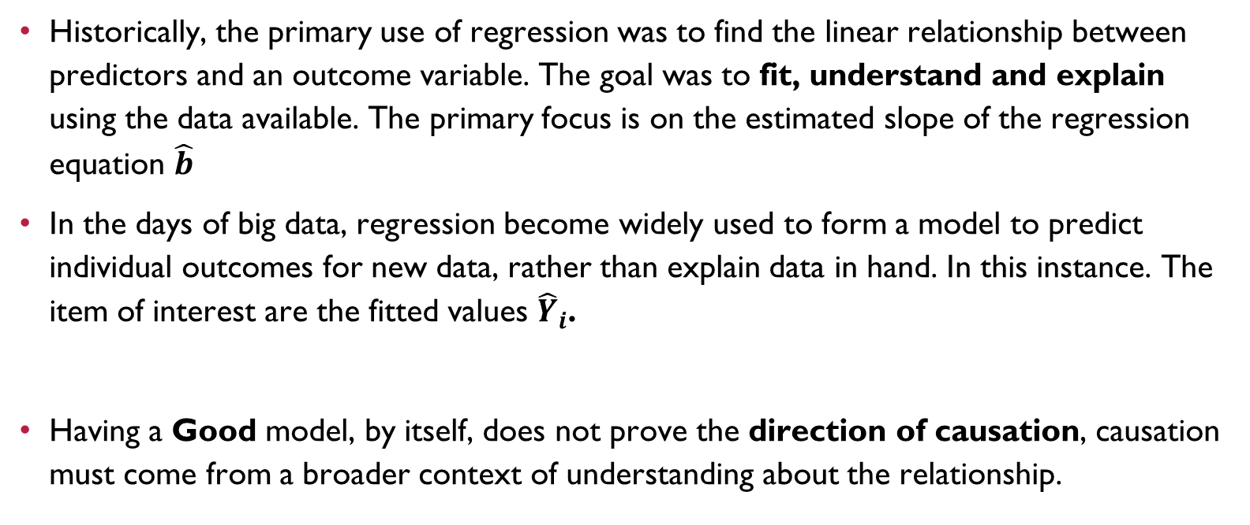
Prediction vs Explanation
Historically, the primary use of regression was to find the linear relationship between predictors and an outcome variable. The goal was to fit, understand and explain using the data available. The primary focus is on the estimated slope of the regression equation $\hat{b}$
In the days of big data, regression become widely used to form a model to predict individual outcomes for new data, rather than explain data in hand. In this instance. The item of interest are the fitted values ${\hat{Y}}_{i}$.
Having a Good model, by itself, does not prove the direction of causation, causation must come from a broader context of understanding about the relationship.
Further Reading
For an in-depth treatment of prediction versus explanation, see Galit Shmueli’s article “To Explain or to Predict”. https://projecteuclid.org/journals/statistical-science/volume-25/issue-3/To-Explain-or-to-Predict/10.1214/10-STS330.full

Slide 10

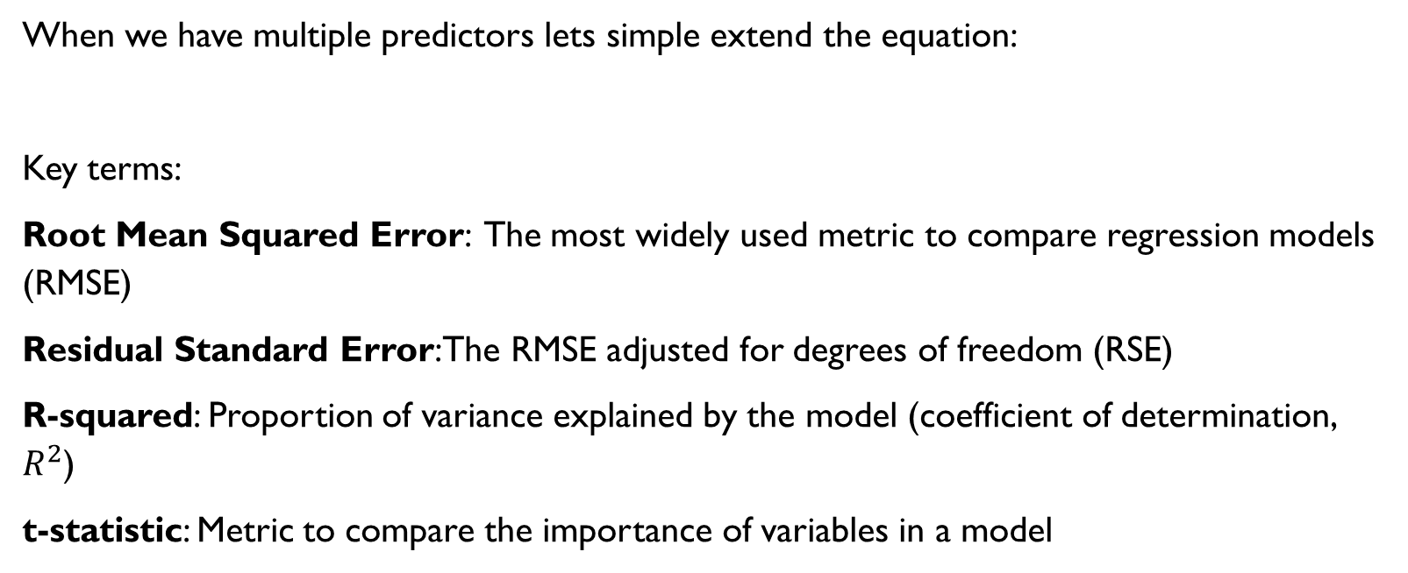
Multiple Linear Regression
When we have multiple predictors lets simple extend the equation:
Key terms:
Root Mean Squared Error: The most widely used metric to compare regression models (RMSE)
Residual Standard Error: The RMSE adjusted for degrees of freedom (RSE)
R-squared: Proportion of variance explained by the model (coefficient of determination, $R^{2}$)
t-statistic: Metric to compare the importance of variables in a model
Y$=b_{0}+b_{1}X_{1}+b_{2}X_{2}+…++b_{p}X_{p}+e$

Slide 11
Multiple linear regression
EXAMPLE

Slide 12

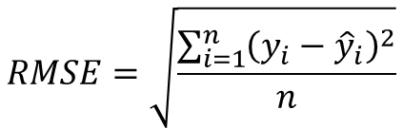
Assessing the model
To ensure you have a good model and potentially good prediction it is necessary to look in detail the following performance metrics
This measures the overall accuracy of the model and is a basis for comparing it to other models.
Takes in count degrees of freedom, tend to be the same in big data applications.
$$RMSE=\sqrt{\frac{\sum_{i=1}^{n}{{\left(y_{i}−{\hat{y}}_{i}\right)}^{2}}}{n}}$$
$$RSE=\sqrt{\frac{\sum_{i=1}^{n}{{\left(y_{i}−{\hat{y}}_{i}\right)}^{2}}}{n−p−1}}$$

Slide 13

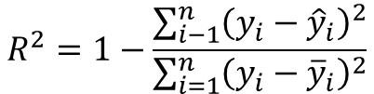
Assessing the model
R-squared measures the proportion of variation in the data accounted to the model and assess how well the linear model fits the data. Typically, you will find the adjusted R-squared, which adjusts for the degrees of freedom.
The t-statistic and its p-value measures the extent to which a coefficient is statistically significant. The Higher the t-statistic (and the lower the p-value), the more significant the predictor. Very useful for variable selection.
$$R^{2}=1−\frac{\sum_{i−1}^{n}{{\left(y_{i}−{\hat{y}}_{i}\right)}^{2}}}{\sum_{i=1}^{n}{{\left(y_{i}−{\overline{y}}_{i}\right)}^{2}}}$$
$$t_{b}=\frac{\hat{b}}{SE\left(\hat{b}\right)}$$

Slide 14
Cross Validation
Statistical regression metrics are all in sample metrics, they are applied to the same data that was used to fit the model. It makes sense to reserve aside some of the original data, not used to fit the model, and then apply the model to the set aside (holdout or test set).
Cross-validation extends the idea of a holdout sample to multiple sequential holdout samples in the K-fold cross-validation algorithm:
Set aside 1/k of the data as a holdout sample.
Train the model on the remaining data/
Apply the model to the 1/k holdout and record model assessment metrics/
Restore the first 1/k of the data, and set aside the next 1/k.
Repeat 2 and 3.
Repeat until each record has been user in the holdout portion.
Average the model assessment metrics.

Slide 15
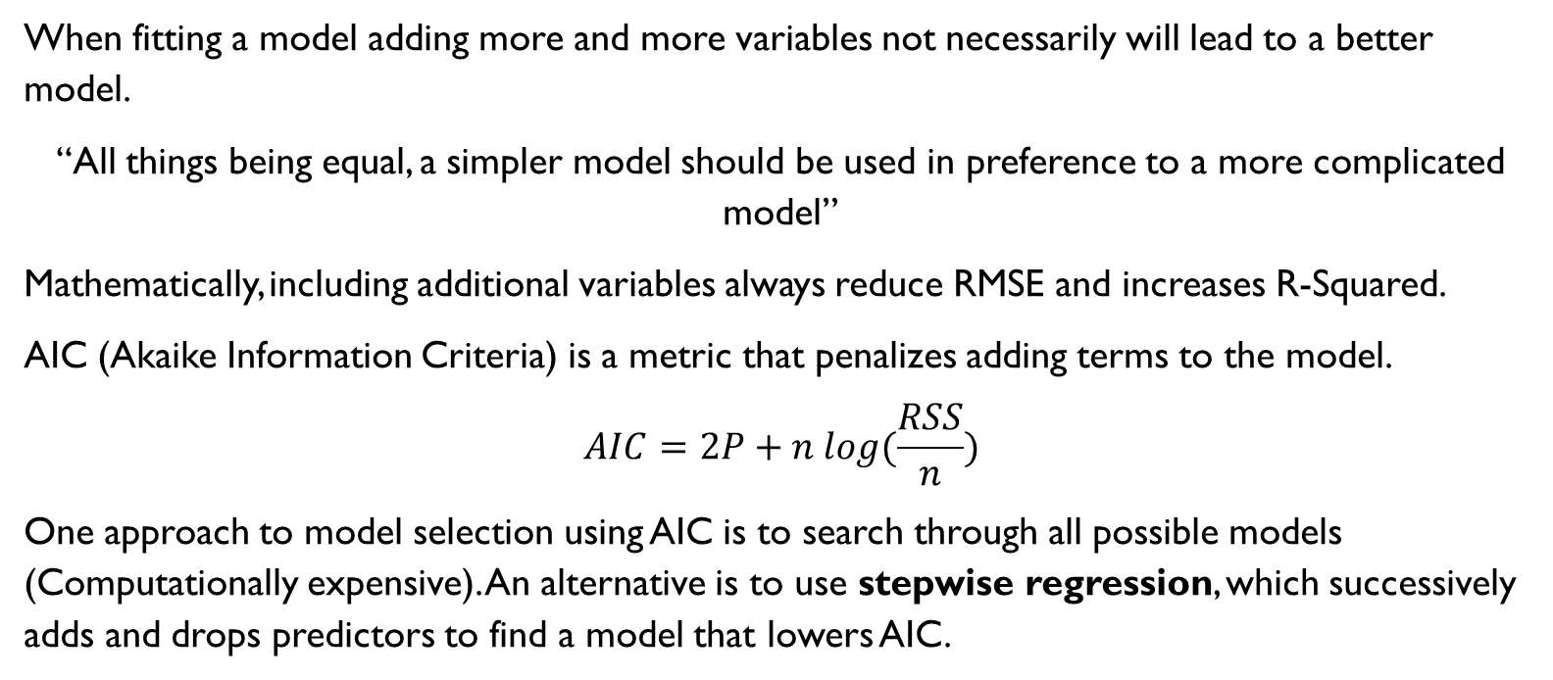
Model selection and Stepwise Regression
When fitting a model adding more and more variables not necessarily will lead to a better model.
“All things being equal, a simpler model should be used in preference to a more complicated model”
Mathematically, including additional variables always reduce RMSE and increases R-Squared.
AIC (Akaike Information Criteria) is a metric that penalizes adding terms to the model.
$$AIC=2P+n log(\frac{RSS}{n})$$
One approach to model selection using AIC is to search through all possible models (Computationally expensive). An alternative is to use stepwise regression, which successively adds and drops predictors to find a model that lowers AIC.

Slide 16
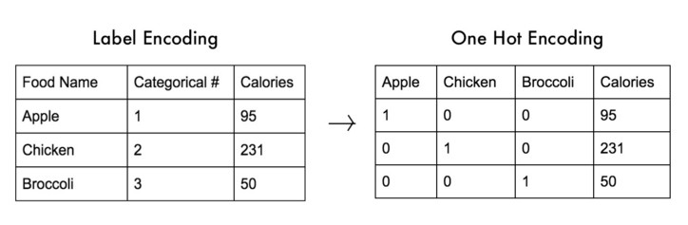
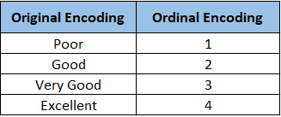
Factor Variables in regression Note
Regression requires numerical inputs, factor or categorical variables need a special treatment and converted to numeric values.
Dummy variable: Binary 1-0 variables derived by recoding factor data for use in regression.
One hot encoding: Type of coding in which all factor levels are retained. Watch out in multiple regression.
Ordinal variable encoding: Encoded with a numerical value but preserving the hierarchical order.

Slide 17
Interpreting The Regression Equation
When the goal of your analysis gaining insights of the relationship between the predictors and the outcome rather than the actual predictions, the following are a few important tricks to examining and interpreting the Regression Equation.
Correlated variables: The predictor variables are highly correlated; this makes difficult to interpret the individual coefficients.
Multicollinearity: Variables have perfect or near perfect correlation. Regression can be unstable or impossible to find convergence.
Main effect: Relationship between the outcome variable, independent from other variables.
Interaction: An interdependent relationship between two or more predictors and the response.

Slide 18
Testing Assumptions
In explanatory analysis, various steps are taken to assess how well the model fits the data.
This steps are based on the analysis of the residuals which can test the assumptions underlying the model.
Linear relationship
Outliers and influential values*
Non heteroskedasticity (constant variance)
Normality of the residuals
Independence of the observations

Slide 19
Linear relationship Pairwise correlation

Slide 20
Outliers
An extreme value, or outlier:
Is a value that is distant from most of the other observation.
A record whose actual value is distant from the predicted value.
Outlier detection by:
Examining the standardized residuals (the number of standard errors away from the regression line)
In a boxplot, points that are too far above or below the box boundaries.

Slide 21
Influential values
A value whose absence would significantly change the regression equation.
Metrics to determine influence:
Hat-value [values above 2(P+1)/n]
Cooks distance [values above 4/(n-P-1)]

Slide 22
Heteroskedasticity
Is the lack of constant residual variance across the range of the predicted values. In other words, errors are greater for some portions of the range than for others.
Heteroskedasticity indicates that prediction errors differ for different ranges of the predicted value and may suggest an incomplete model.

Slide 23
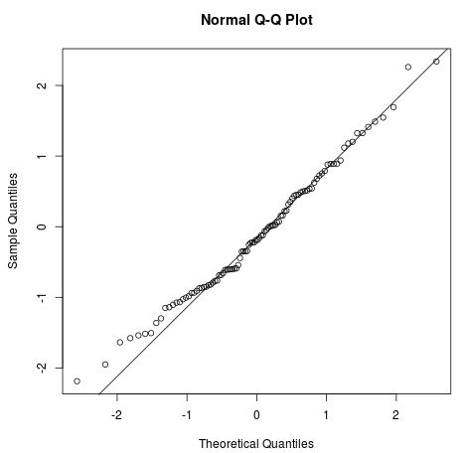
Normality
Residuals must be normally distributed.
Verify it by Graphical methods:
Histogram
Normal Q-Q plot
Or Normality tests:
Shapiro
Kolmogorov
Is possible to solve it applying non-linear transformations.

Slide 24
Further topics
Mixed effects regression
Non-linear regression
Polynomial regression
Spline regression
Regularization
Lasso Regression
Ridge Regression
Generalized Additive Models
An Introduction to Statistical Learning by Hastie & Tibshirani

Slide 25
Summary
Regression is the method that has seen greater use over the years and one fundamental tool for a data scientist.
The main assumption of LR implies that each predictor has a coefficient that describe a linear relationship between the predictor and the outcome.
In classic statistics the emphasis is on finding a good fit to explain and describe the phenomenon, in current data science, the goal is typically to predict values for new data.
Variable selection methods are used to reduce dimensionality an create compact models.

